Slide 1
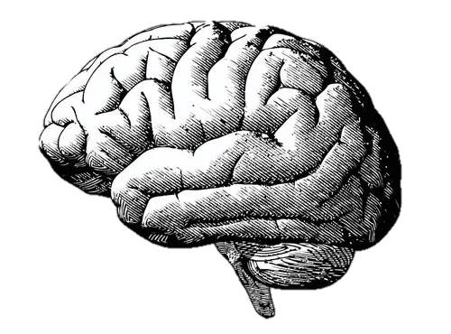
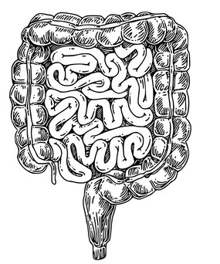
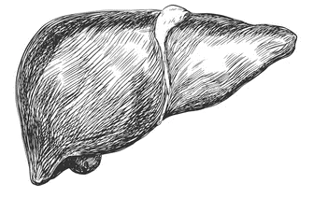


Neurologic Complications of Liver and GI Diseases
Mohammad Almeqdadi, MD
Transplant Hepatologist
Assistant Professor of Medicine and Surgery
Tufts University School of Medicine

Slide 2
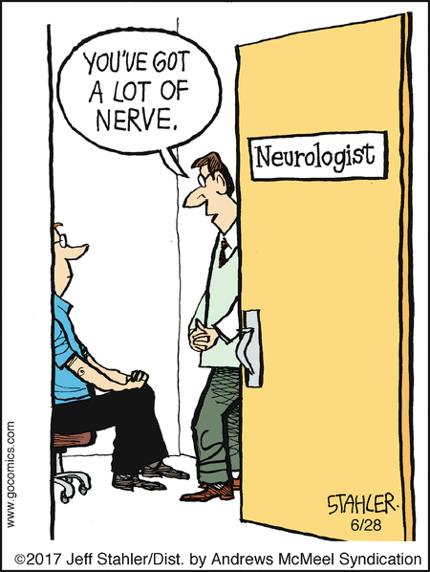
Liver-Gut-Brain Axis
Many disease intersect between those organs
Neurologic diseases with GI manifestations
GI diseases with neurologic manifestation
Liver disease with neurologic manifestations

Slide 3

Hepatic Encephalopathy

Slide 4
Hepatic Encephalopathy
Brain dysfunction caused by
  liver insufficiency
  and/or
  portosystemic shunting (think TIPS)
“Toxins” that are cleared by the liver -> circulation –BBB-> Brain
Elevated ammonia and glutamate levels are implicated

Slide 5
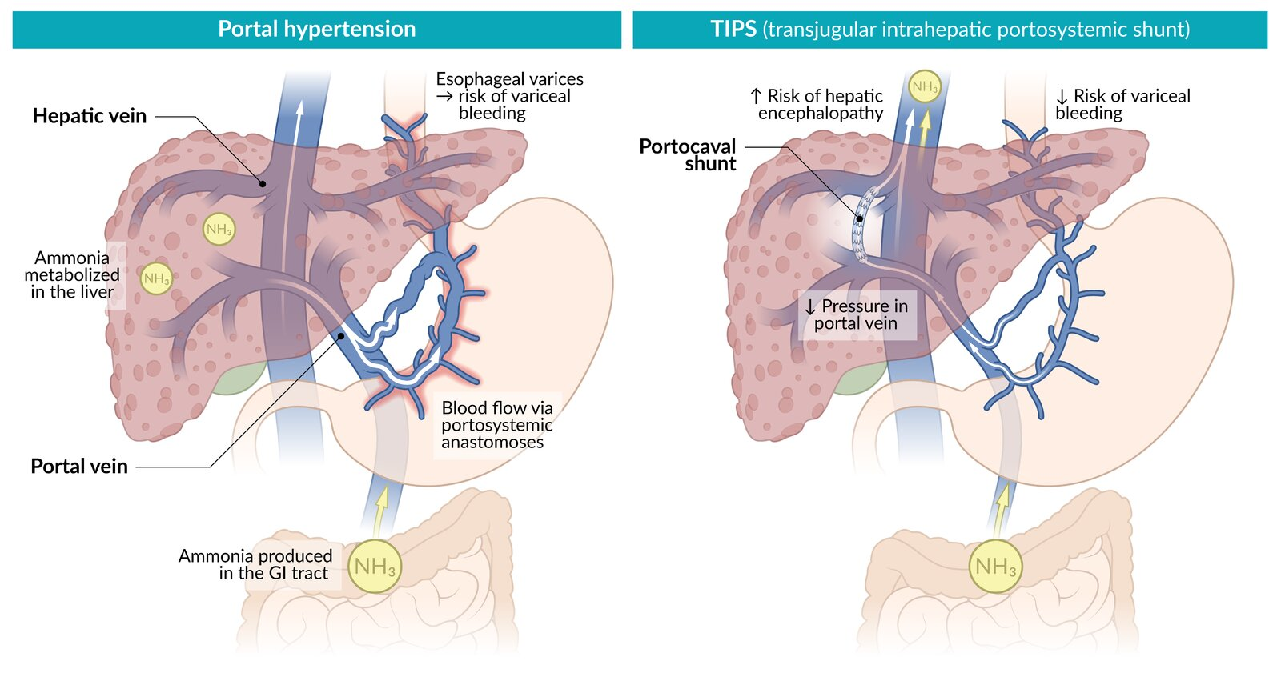

Slide 6
Neuropathophysiology

Slide 7
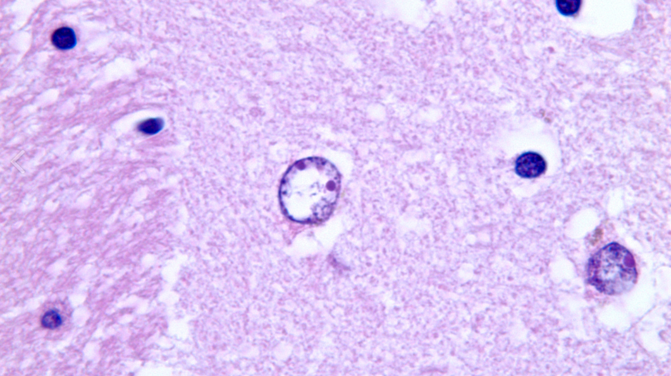

Slide 8
Glutamate
Glutamine

Slide 9
Glutamate
X
Glutamine

Slide 10
Glutamate
X
Glutamine
✨
magic
Encephalopathy

Slide 11
Glutamate
X
Glutamine
Alzheimer type II astrocyte
✨
magic
Encephalopathy

Slide 12
Axes of Hepatic Encephalopathy
Type of hepatic encephalopathy
  Acute liver failure (A)
  Portosystemic shunts (B)
  Cirrhosis (C)
Grades
  West Haven Criteria
  International Society for Hepatic Encephalopathy and Nitrogen Metabolism (ISHEN) criteria
Time course
  Episodic
  Recurrent
  Persistent
Precipitating factors
  Yes
  Spontaneous

Slide 13
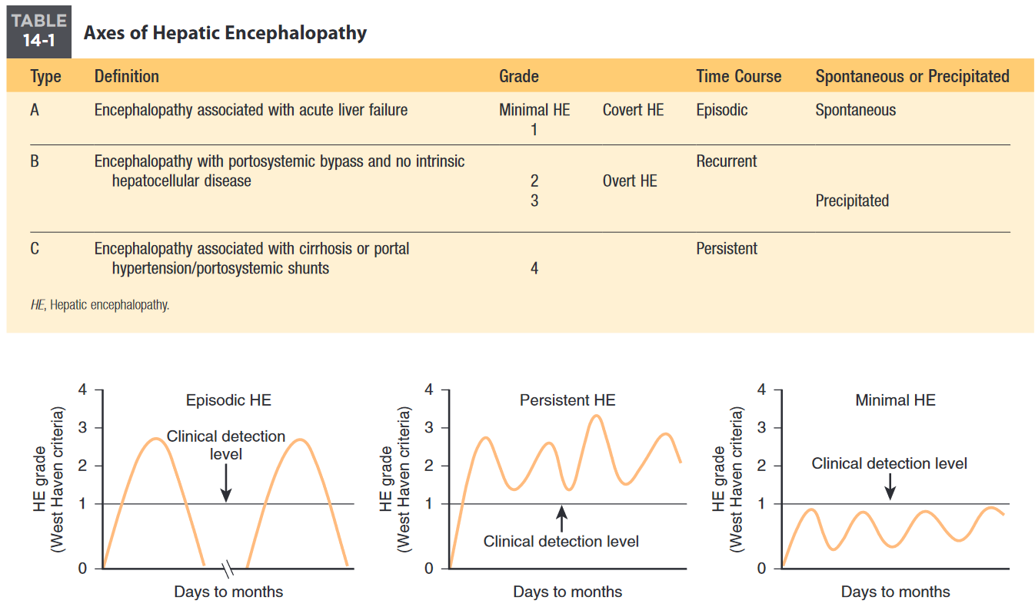

Slide 14
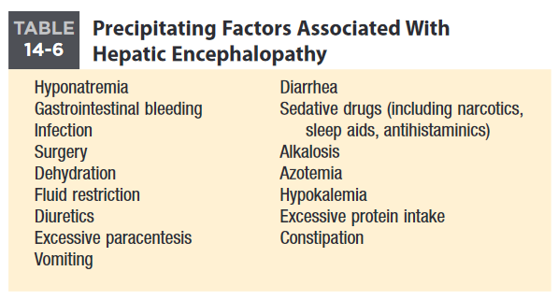

Slide 15
Clinical Hepatic Encephalopathy
20% to 80% of patients with cirrhosis have minimal or covert HE
How do we test for minimal and/or covert HE?

Slide 16
Minimal or covert HE
Clinically, psychometric or neuropsychologic alterations
No change in mental status
Euphoria or anxiety
Reduced attention span
Altered ability to perform arithmetic operations
Change in sleep-wake cycle

Slide 17
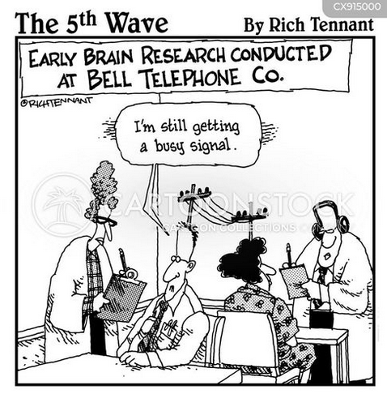
Anything on EEG?

Slide 18
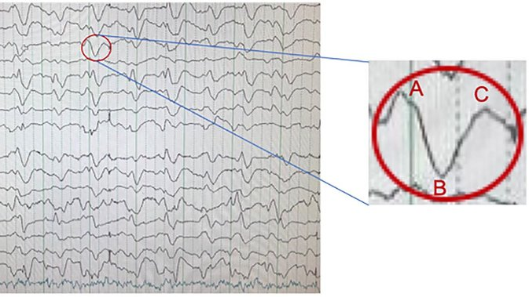

Slide 19
EEG in hepatic encephalopathy
Frontal slowing in delta range 1-3 Hz
Triphasic waves
More useful to follow patient’s progression, than as an initial diagnostic tool

Slide 20
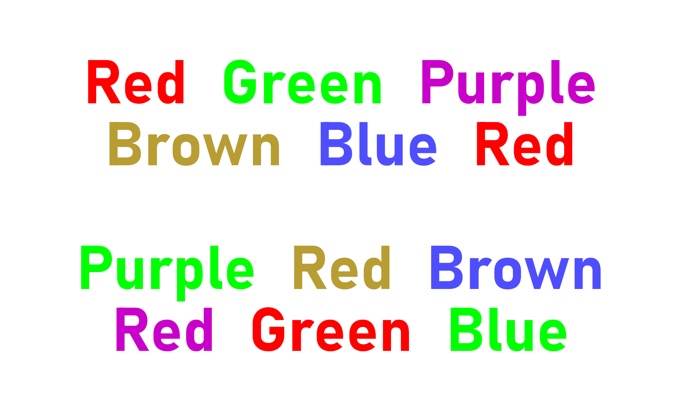
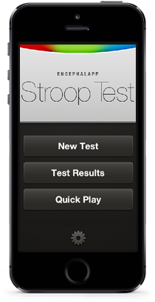
Stroop Test

Slide 21


Slide 22
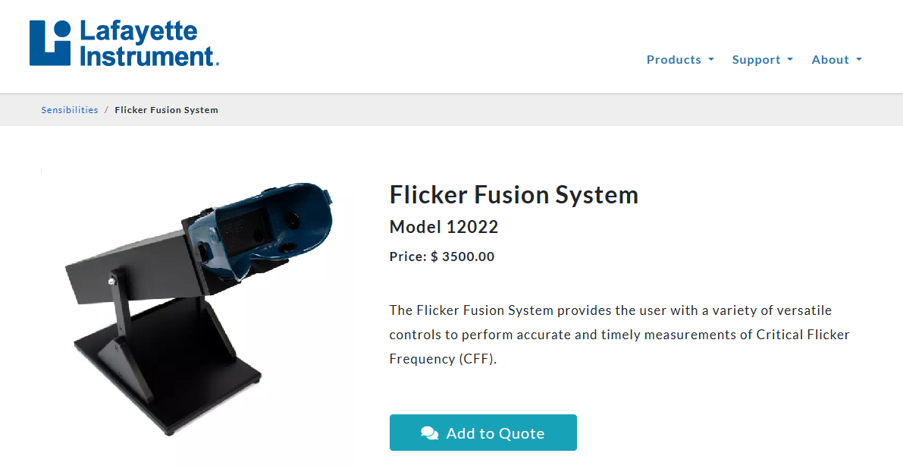
PMID: 29530628

Slide 23
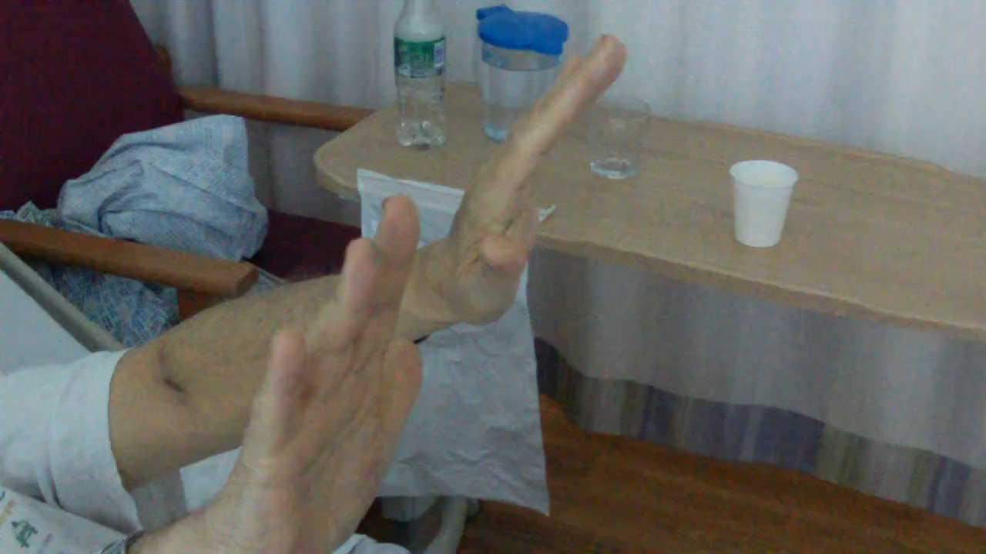

Slide 24
Asterixis
What is the neurologic terminology that describes asterixis?
What is the underlying pathophysiologic mechanism?
Can you diagnose it with an EMG? How about an EEG? Both?

Slide 25
Asterixis
What is the neurologic terminology that describes asterixis?
  Subcortical negative myoclonus
What is the underlying pathophysiologic mechanism?
  Up for debate
Can you diagnose it with an EMG? How about an EEG? Both?
  Both!

Slide 26
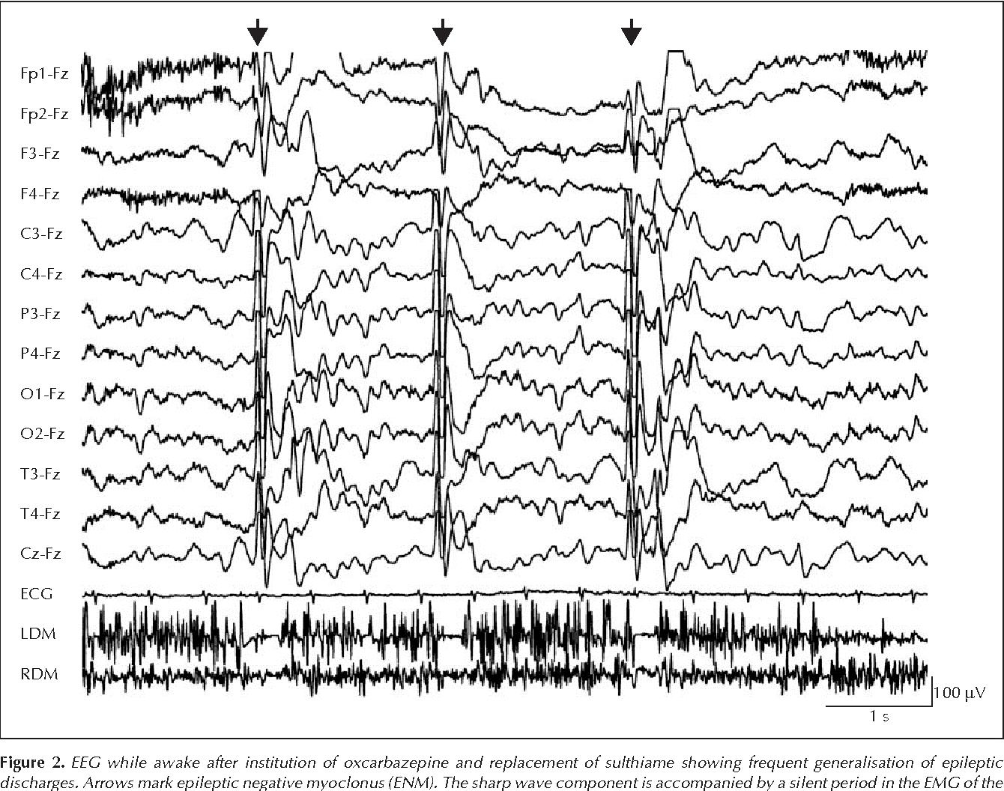
Is this consistent with asterixis?

Slide 27
Quiz
A 41-year-old lady with history of Crohn disease requiring multiple surgeries ending with short gut syndrome, started on TPN 3 months ago, now presents with tremor and a shuffling gate.
An MRI was performed.

Slide 28
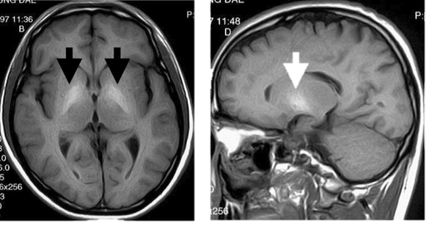

Slide 29
Quiz
Which of the following is the pathophysiologic cause of her symptoms?
  Aluminum toxicity
  Aluminum deficiency
  Selenium toxicity
  Selenium deficiency
  Manganese toxicity
  Manganese deficiency
  De novo Parkinson’s disease
  IBD-associated neurotixicity

Slide 30
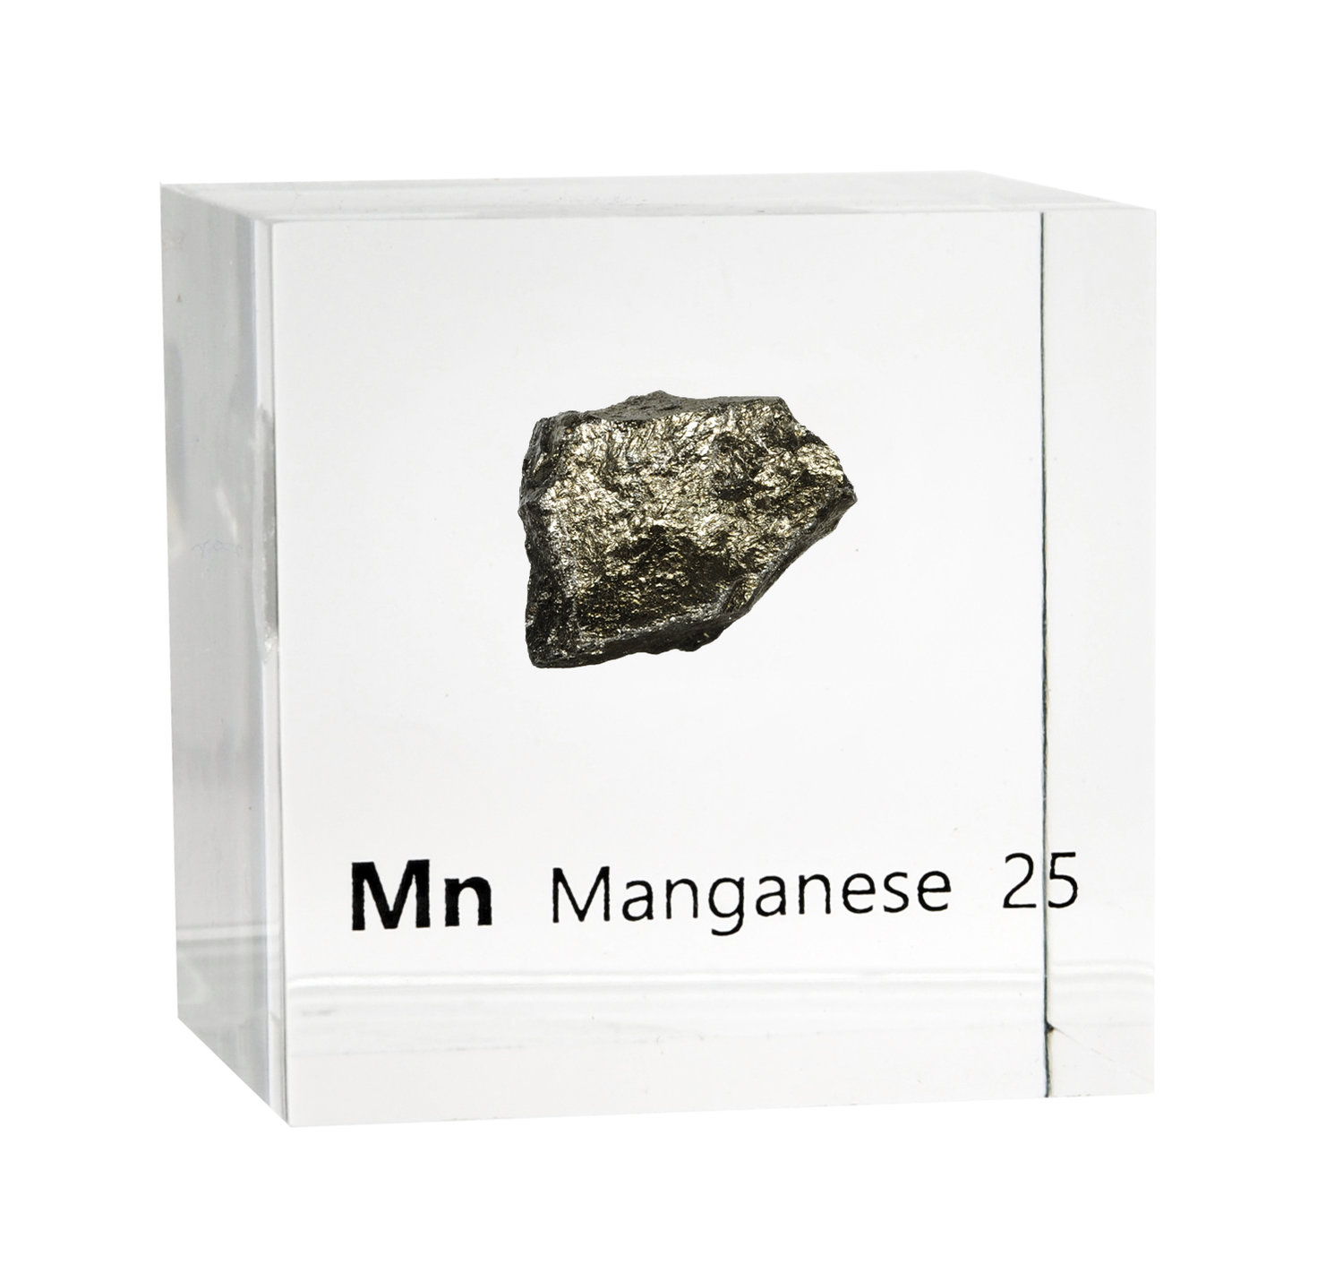

Slide 31

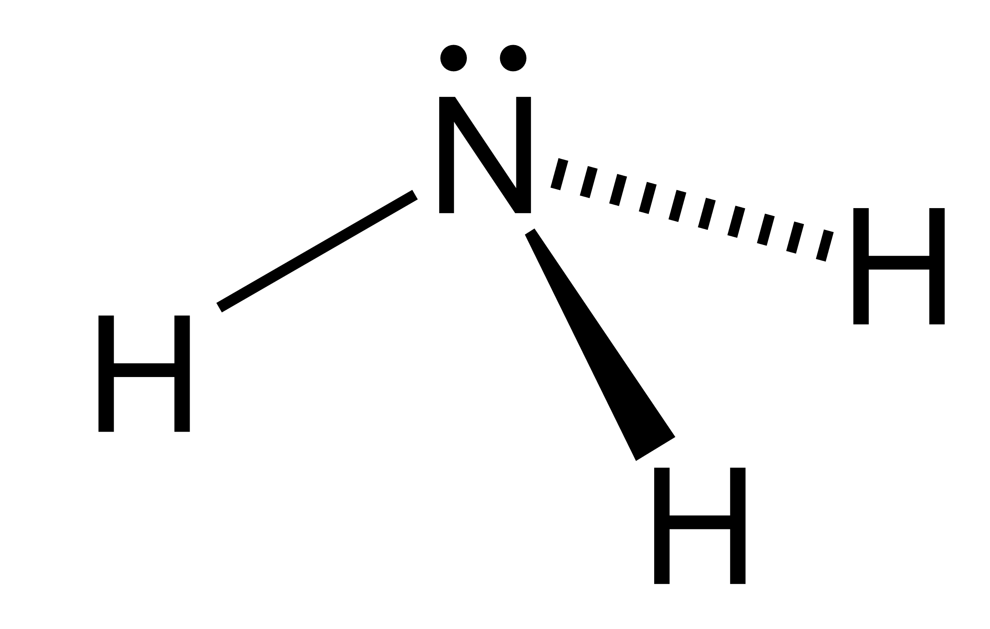
How about ammonia levels?

Slide 32
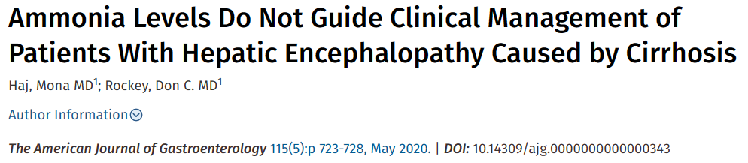
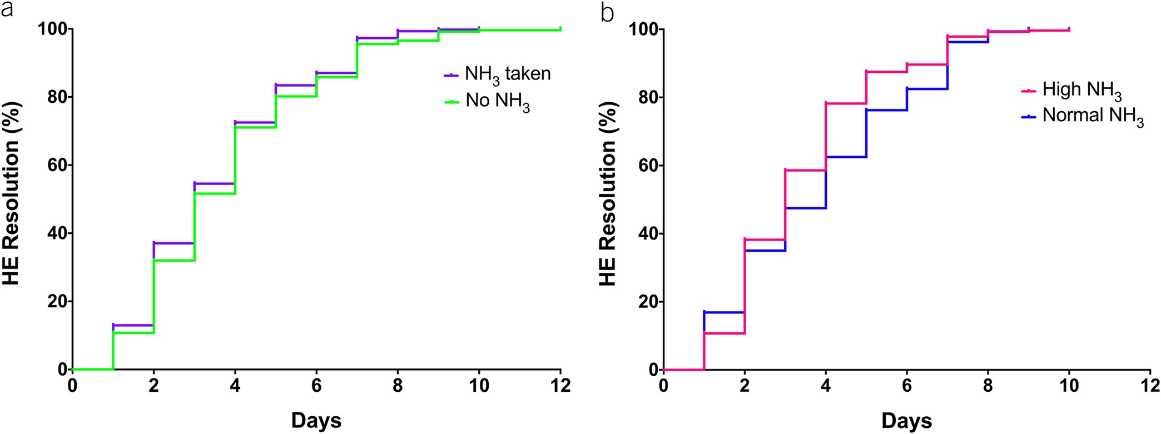
HE clearing as a function of ammonia level. Clearing was defined as achieving West Haven stage 0 or returning to baseline mental status. Shown are Kaplan-Meier plots of time to clearing (days) in patients with ammonia levels drawn compared to those without an ammonia level drawn (a), as well as clearing rates in those with normal and elevated ammonia levels (b). HE, hepatic encephalopathy.

Slide 33
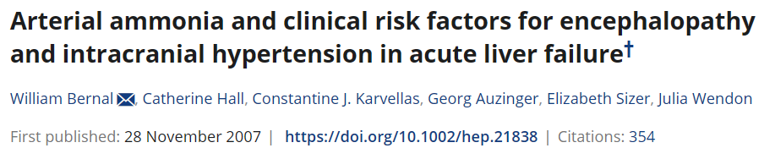
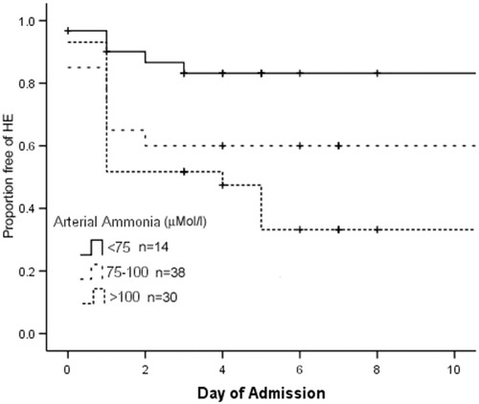
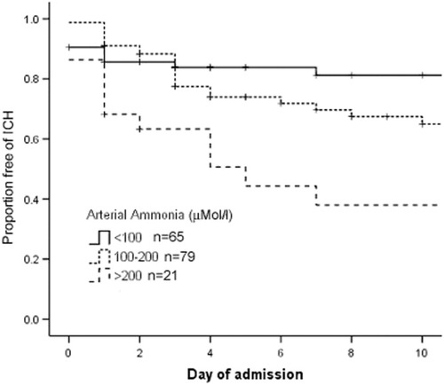

Slide 34
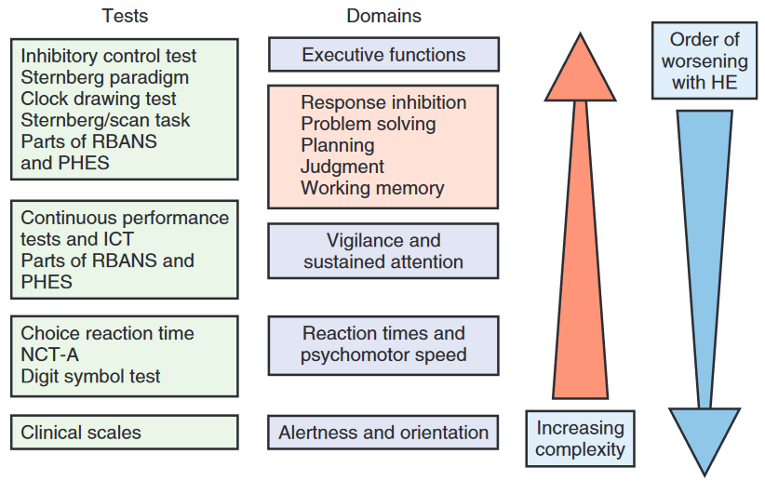

Slide 35
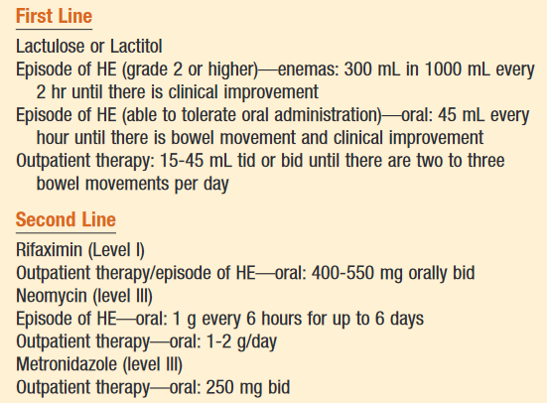
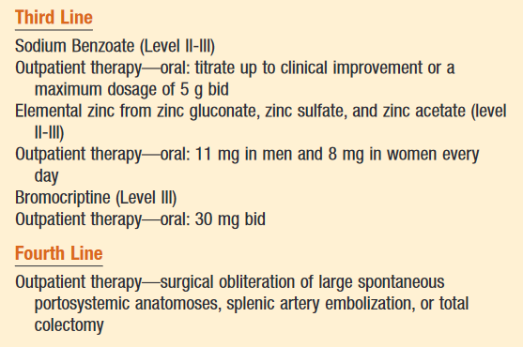
Treatment of Hepatic Encephalopathy

Slide 36
Quiz
A 54-year-old man is seen in the clinic with progressive cognitive decline, tremors, and difficulty with coordination over the past year. He also reports a chronic history of alcohol abuse and intermittent jaundice. On examination, he exhibits asterixis, dysarthria, and hyperreflexia. His liver function tests are abnormal, showing elevated transaminases and bilirubin. MRI of the brain reveals bilateral T2 hyperintense lesions in the basal ganglia.
What is the most likely underlying cause of his neurological symptoms?
  A) Wilson's disease
  B) Hepatocerebral degeneration
  C) Hepatic encephalopathy
  D) Multiple sclerosis

Slide 37

Acquired Non-Wilsonian
Hepatocerebral Degeneration

Slide 38
Hepatocerebral Degeneration
Can be confused with Wilson disease
Variable presentation including:
  Parkinsonism
  Cognitive decline
  Ataxia
  Dystonia
  Cranial dyskinesias
  Chorea
Pathophysiological hypothesis: Manganese deposits!
  In basal ganglia and cerebellum

Slide 39
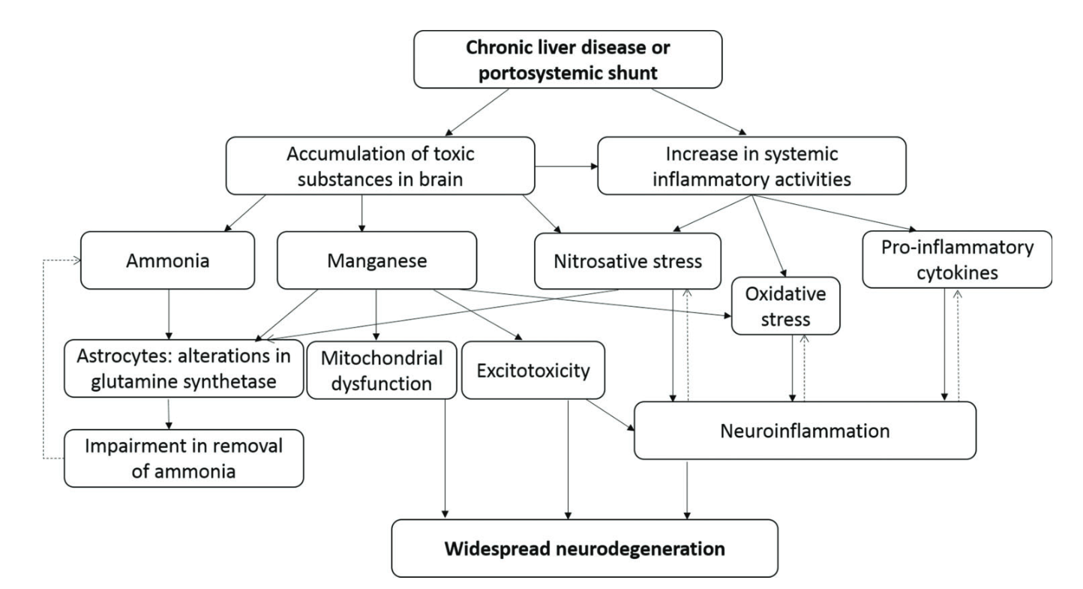
Tremor Other Hyperkinet Mov (N Y). 2017 Sep 5;7:463

Slide 40
How to differentiate from Wilson?
Characteristic | Hepatocerebral Degeneration | Wilson Disease
Age
Ceruloplasmin
Genetics
Kayser-Fleischer rings

Slide 41
How to differentiate from Wilson?
Characteristic | Hepatocerebral Degeneration | Wilson Disease
Age | Old | Young
Ceruloplasmin | Normal/High | Low
Genetics | Wild type | ATP7B Gene Mutation
Kayser-Fleischer rings | Not present | Present

Slide 42
So if Manganese is so toxic, why not chelate it?

Slide 43
Treatment of Hepatocerebral Degeneration
Trientine
  Chelates manganese
  Improves parkinsonian symptoms
  Eliminates abnormal signal intensity on brain MRI
Branched-Chain Amino Acids (BCAAs)
  Compete with aromatic amino acids (AAAs) for blood-brain transport
  Reduce AAA entry into the brain
  Improves neurological deficits in AHD patients
  Case reports show improvements in imaging findings and symptoms:
    Parkinsonism
    Cerebellar ataxia
Balloon-Occluded Retrograde Transvenous Obliteration (BRTO)
  Elective treatment for gastric varices in liver cirrhosis patients
  Improves ataxia and parkinsonism
  Reverses abnormal brain MRI signals
Portosystemic Shunt Obliteration via Percutaneous Transvenous Embolization
  Improves cerebellar symptoms
  Reverses abnormal brain MRI findings

Slide 44
Treatment of Hepatocerebral Degeneration
Only anecdotal therapies and no real recommendations about which therapies will improve long-term outcomes
Mostly case reports

Slide 45
Treatment of Hepatocerebral Degeneration
But remember
The problem is the LIVER! HEPATO….cerebral

Slide 46

Does liver transplant reverse hepatocerebral degeneration?

Slide 47
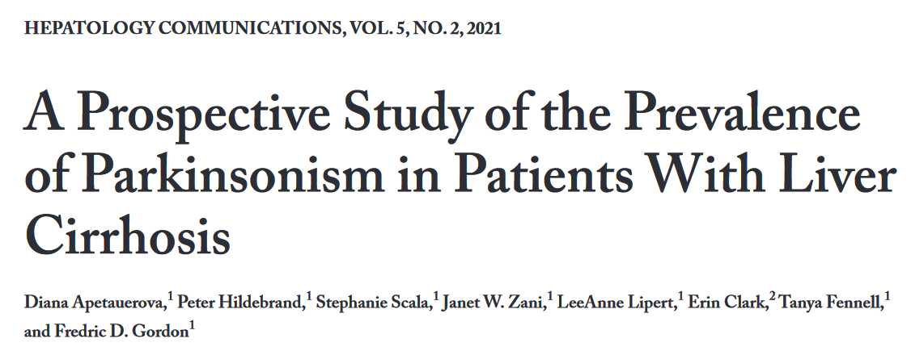

Slide 48
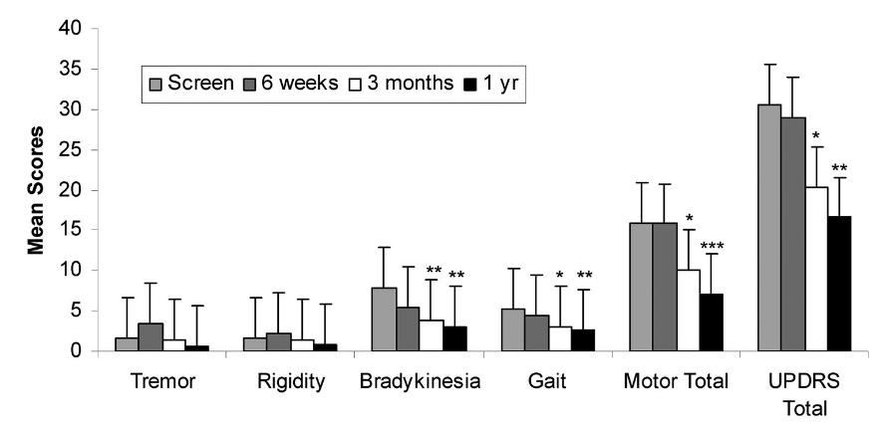
n=18

Slide 49
Quiz
A 34-year-old man presents to the clinic with fatigue, jaundice, and neurological symptoms including tremors and difficulty speaking. His ceruloplasmin level is found to be low, and a 24-hour urinary copper excretion test shows elevated levels of copper. His ophthalmologic exam reveals Kayser-Fleischer rings.
What is the next most definitive diagnostic step to confirm the underlying disease?
  A) Genetic testing for ATP7B mutations
  B) Liver function tests
  C) MRI of the brain
  D) Liver biopsy
  E) Serum copper level

Slide 50
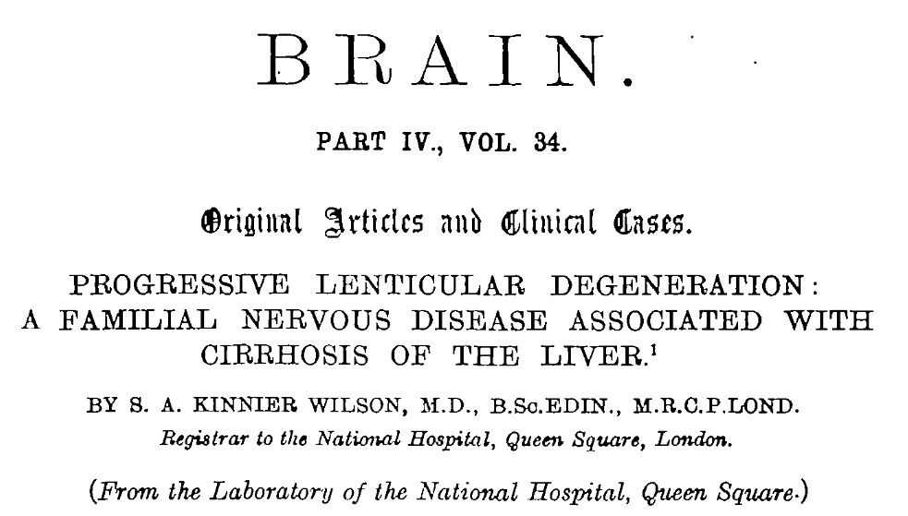


Slide 51

Wilson Disease

Slide 52
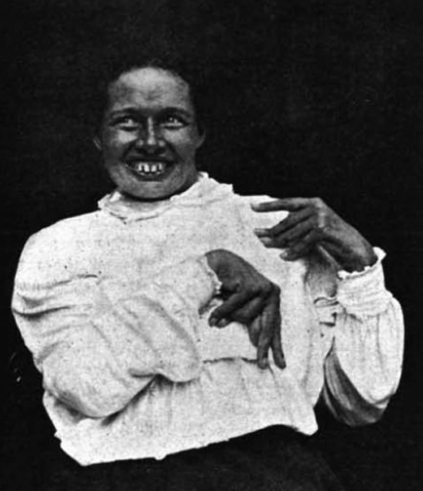
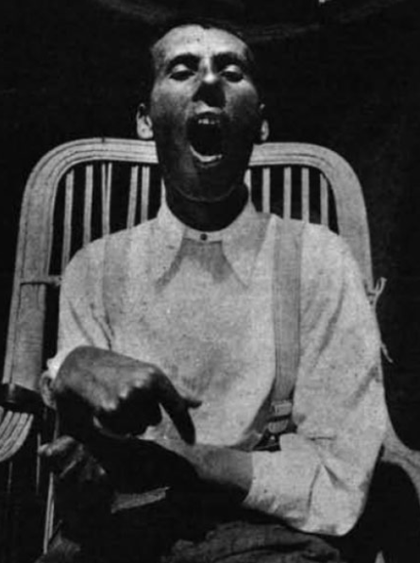
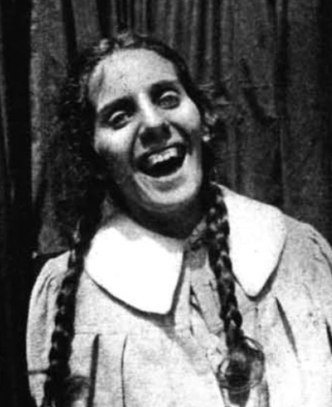

Slide 53
What is the name of this sign?

Slide 54
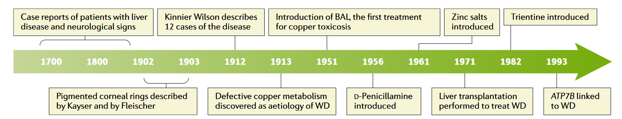
Nat Rev Dis Primers. 2018 Sep 6;4(1):21.

Slide 55
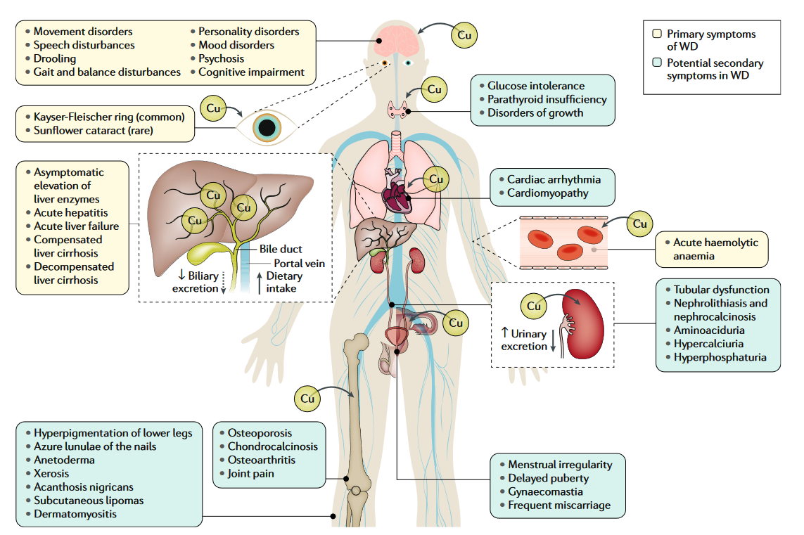
Nat Rev Dis Primers. 2018 Sep 6;4(1):21.

Slide 56
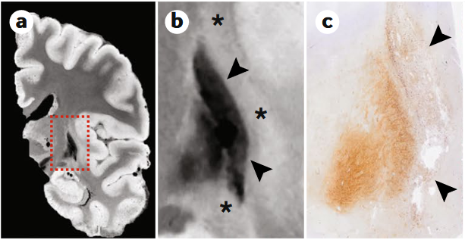
What staining should be used to look at those areas histologically?
Nat Rev Dis Primers. 2018 Sep 6;4(1):21.
Notes:
Fig. 5 | Post-mortem MRI and histopathology in neurological WD. MRI and histological images taken post-mortem from
a patient with neurological Wilson disease (WD). a | T2*-weighted post-mortem MRI acquired with a 7T scanner.
b | Magnification of the basal ganglia region marked by the dashed red rectangle in part a; note the shrunken and markedly
hypointense putamen and globus pallidus (marked by black arrowheads) surrounded by a mildly hyperintense area (marked
by asterisks). c | Low-power magnification of Turnbull iron staining displaying the corresponding area with MRI on image in
part b; increased iron staining corresponds with abnormally low MRI T2* signal in parts a and b. d,e | Haematoxylin and
eosin staining showing reactive astrocytes with large pale nuclei (black arrowheads) and severely damaged neurological
tissue with macrophages (black arrows); note that part d corresponds to the T2* hyperintense area directly adjacent to the
putamen whereas part e corresponds to a rarefied area in the central putamen. f | Berlin-blue staining showing iron-
negative (black arrows) and iron-positive (black arrowheads) macrophages. Iron is faintly present also in astrocytes (white
arrowhead) and as iron dust with dominant perivascular distribution (vessel marked by asterisk); this finding indicates
diffusely increased tissue iron deposits. g | Ferritin staining shows numerous strongly positive macrophages (black
arrowheads) that drive the MRI T2* signal drop. Of note, the presence of iron-laden macrophages leads to a profoundly
decreased T2* signal even in the putamen, with severe tissue rarefaction. Scale bars in images in parts d–g represent 50 μm

Slide 57
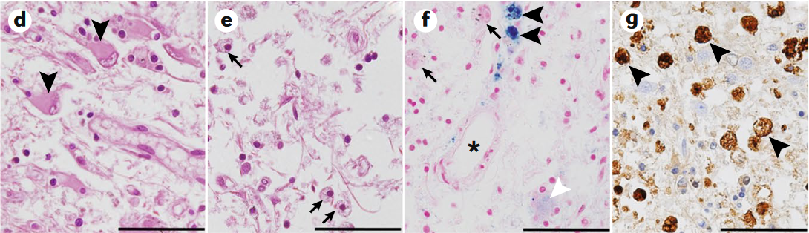
IRON staining
not copper!
IRON staining
not copper!
Nat Rev Dis Primers. 2018 Sep 6;4(1):21.
Notes:
Fig. 5 | Post-mortem MRI and histopathology in neurological WD. MRI and histological images taken post-mortem from
a patient with neurological Wilson disease (WD). a | T2*-weighted post-mortem MRI acquired with a 7T scanner.
b | Magnification of the basal ganglia region marked by the dashed red rectangle in part a; note the shrunken and markedly
hypointense putamen and globus pallidus (marked by black arrowheads) surrounded by a mildly hyperintense area (marked
by asterisks). c | Low-power magnification of Turnbull iron staining displaying the corresponding area with MRI on image in
part b; increased iron staining corresponds with abnormally low MRI T2* signal in parts a and b. d,e | Haematoxylin and
eosin staining showing reactive astrocytes with large pale nuclei (black arrowheads) and severely damaged neurological
tissue with macrophages (black arrows); note that part d corresponds to the T2* hyperintense area directly adjacent to the
putamen whereas part e corresponds to a rarefied area in the central putamen. f | Berlin-blue staining showing iron-
negative (black arrows) and iron-positive (black arrowheads) macrophages. Iron is faintly present also in astrocytes (white
arrowhead) and as iron dust with dominant perivascular distribution (vessel marked by asterisk); this finding indicates
diffusely increased tissue iron deposits. g | Ferritin staining shows numerous strongly positive macrophages (black
arrowheads) that drive the MRI T2* signal drop. Of note, the presence of iron-laden macrophages leads to a profoundly
decreased T2* signal even in the putamen, with severe tissue rarefaction. Scale bars in images in parts d–g represent 50 μm

Slide 58
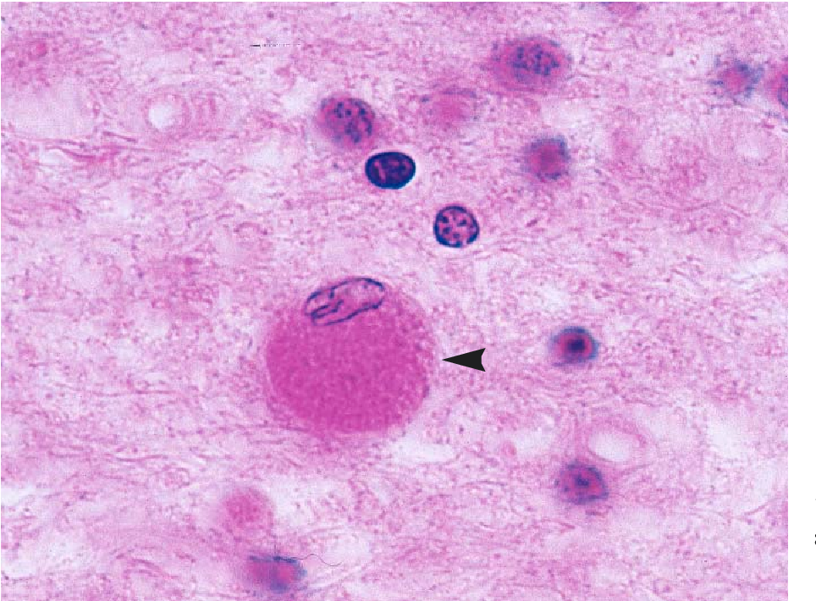

Slide 59
Opalski Cell

Slide 60
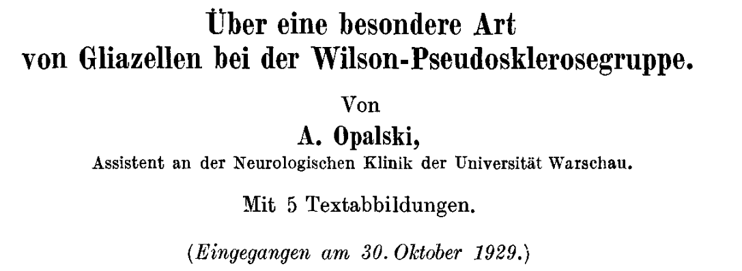
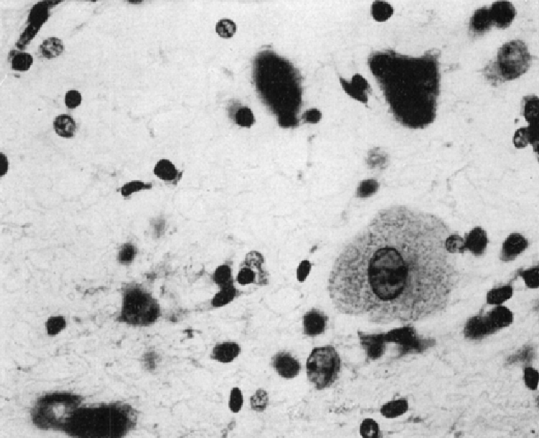
On a special type of glial cells in the Wilson's pseudosclerosis group.
By
A. Opalski,
Assistant at the Neurological Clinic of the University of Warsaw.
A large (up to 35 μm in diameter) altered glial cell, originated from degenerating astrocytes, with small, eccentric, pyknotic, densely staining nuclei (single or multiple) displaced to the periphery, and fine granular cytoplasm, found in the cortical and subcortical regions

Slide 61
Quiz
Which of the following is the first and which one is the most common neurologic symptom of Wilson Disease?
  Dysarthria
  Gait disturbances
  Dystonia
  Parkinsonism
  Ataxia

Slide 62
Neurologic Wilson Disease
Dystonia is the first symptom in up to 65% of patients
  Focal, segmental, multi-segmental or generalized
Dysarthria is the most common symptom up to 97%
Risus sardonicus is one of the characteristic findings
Parkonsinism in up to 62% of patients
  Symmetric bradykinesia
  Rigidity
  Hypomimia
  Gait/posture disturbances
  Dysphagia, drooling
Cerebellar symptoms in ~30% of patients
Nat Rev Dis Primers. 2018 Sep 6;4(1):21.

Slide 63
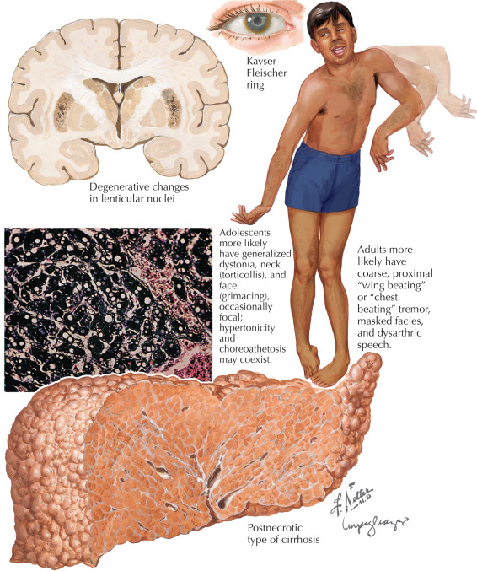

Slide 64


Name this sign?

Slide 65
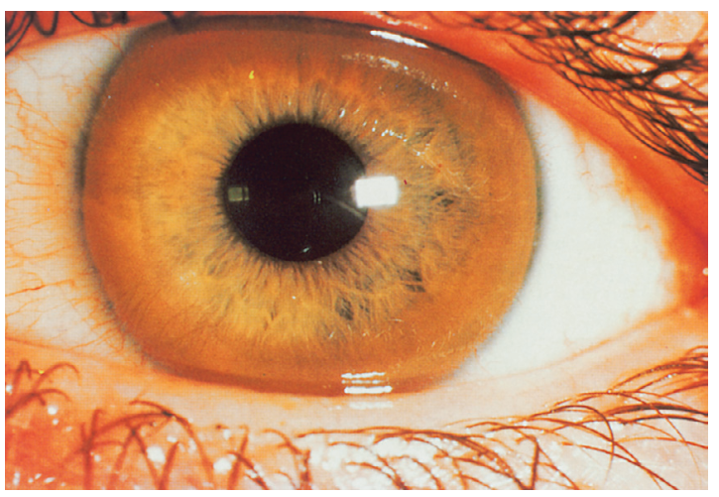
What percent of patients with Wilson Disease have this sign?

Slide 66
What percent of patients with Wilson Disease have this sign?
100% of patients with neurologic Wilson Disease
~50% of patients with hepatic Wilson Disease
~25% of presymptomatic Wilson Disease

Slide 67
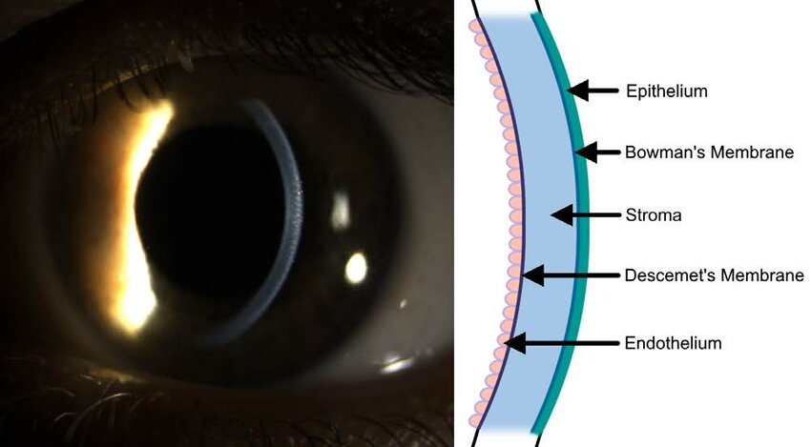
Cu
Transplant Direct. 2023 Jan 12;9(2):e1434

Slide 68
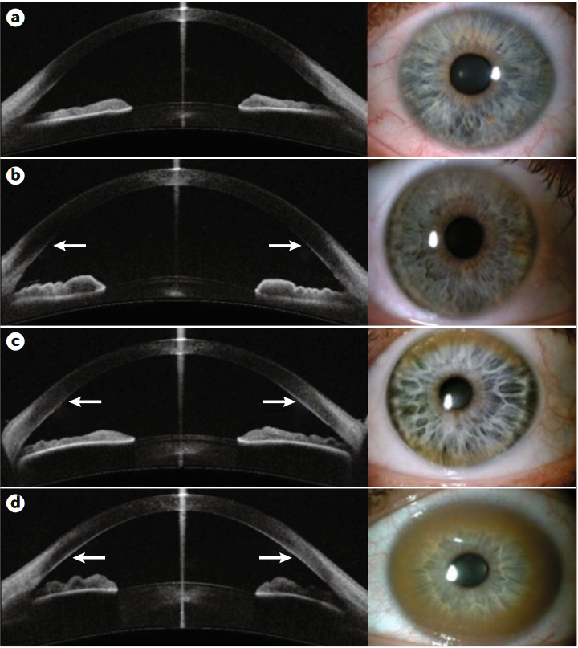
Nat Rev Dis Primers. 2018 Sep 6;4(1):21.
Notes:
Kayser-Fleischer rings in WD. Anterior segment optical coherent tomography
(OCT) of the eye in healthy individuals and patients with Wilson disease (WD). In some
patients with WD and in healthy individuals, corneal copper deposits are not seen
(part a). However, in a substantial proportion of patients with WD, copper deposits can
be visualized by anterior segment OCT as hyper-reflective points that are discrete
(part b), on the superior and inferior part of the cornea (part c) or in the formation of
a complete Kayser-Fleischer ring (part d). Images courtesy of K. Broniek and J. Szaflik, the
Department of Ophthalmology, Medical University of Warsaw, Warsaw, Poland.

Slide 69
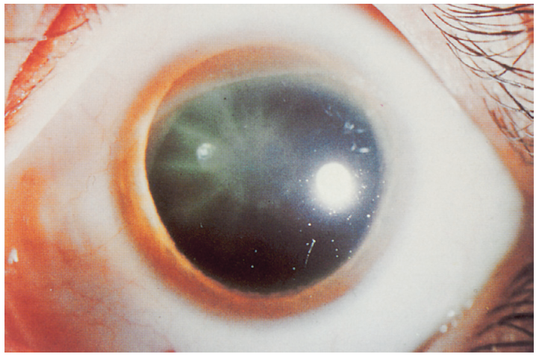

Slide 70
Sunflower cataracts occur in 2-20% of patients with Wilson Disease

Slide 71

Panda and Wilson Disease?

Slide 72
Panda and Wilson Disease?
Face of the Giant Panda
+
Face of the miniature Panda
=
Double Panda Sign!

Slide 73
Quiz
The face of the Giant Panda is formed by differentials of intensities on T2 weighted MRI images of the following structures:
Structure | Intensity | Giant Panda Part
Tegmentum
Red nucleus
Pars reticulata of SN
Superior colliculus

Slide 74
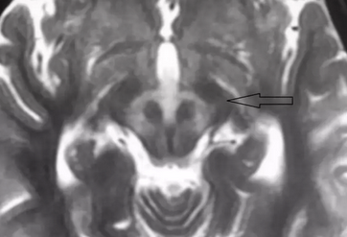
Quiz
The face of the Giant Panda is formed by differentials of intensities on T2 weighted MRI images of the following structures:
Structure | Intensity | Giant Panda Part
Tegmentum | High | Face
Red nucleus | Normal | Eyes
Pars reticulata of SN | Normal | Ears
Superior colliculus | Low | Mouth

Slide 75
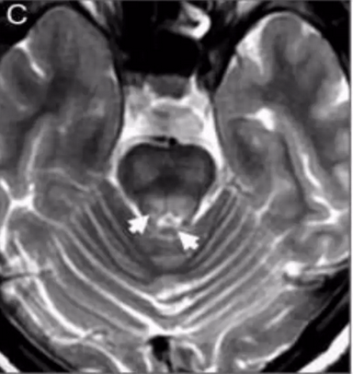
Face of the miniature Panda

Slide 76
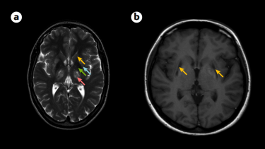
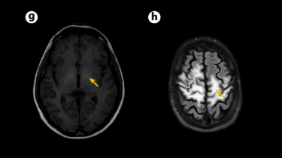
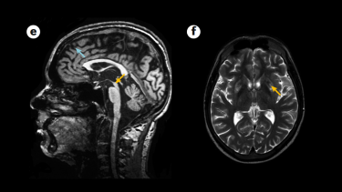

MRI Findings in Wilson Disease
Notes:
Brain MRI changes in WD. Usual abnormalities in brain MRI in patients with Wilson disease (WD) include
symmetric hyperintense changes visualized in T2-weighted images of the basal ganglia, particularly the putamen
(blue arrow), caudate nuclei (orange arrow), thalami (pink arrow) and globi pallidi (green arrow) (part a).
In more advancedcases, severe tissue damage can be visualized in T1-weighted images as hypointensity in the putamen (part a, blue arrow;
part b, orange arrows).
The most spectacular changes observed in WD are described as the ‘face of the giant panda’ in the
midbrain (part c, orange arrow).
Another common MRI abnormality is increased T2 signal along the dentato-rubro-thalamic
pathway (part d, orange arrow), which is a major efferent pathway from the cerebellum involved in movement disorder
symptoms, including ataxia, tremor and dystonia. In severe neurological WD, diffuse brain atrophy (part e) may be seen in
the midbrain (orange arrow) and cortex (blue arrow). In brain MRI scans from a 21-year-old male with severe liver failure
and discrete neurological signs, hyperintense changes in putamina can be visualized in T2-weighted images, which is
characteristic of early stages of brain involvement (part f, orange arrow). Hyperintense changes in the globi palidi in
T1-weighted images in the same patient are presumably due to manganese accumulation, which is characteristic of
hepatic encephalopathy (part g, orange arrow). Very rarely, diffuse white matter changes in both brain hemispheres are
observed with preservation of the cortex, probably due to myelin destruction (part h, orange arrow).

Slide 77


Slide 78


Slide 79


Slide 80


Slide 81

How to diagnose neurologic Wilson Disease?

Slide 82

Hepatology. 2022 Dec 7. doi: 10.1002/hep.32801

Slide 83
Hepatology. 2022 Dec 7. doi: 10.1002/hep.32801

Slide 84
Treatment
Chelation with trientine or D-penicillamine
Zinc adjuvant therapy
Liver transplant!

Slide 85
Quiz
A 54-year-old man presents to your clinic with a 6-month history of chronic diarrhea, abdominal pain, and weight loss. He reports intermittent cognitive impairment, difficulty with balance and coordination, and recent seizures.
On neurological examination, the patient is alert but disoriented to time and place. He has a mild-moderate dysmetria and dysdiadochokinesia in both upper and lower extremities. His deep tendon reflexes are brisk, and he displays a positive Romberg sign. Sensory examination is unremarkable, and there are no signs of peripheral neuropathy. Cranial nerve examination reveals vertical gaze palsy but no other abnormalities. Muscle strength is preserved throughout, and no signs of spasticity or rigidity are noted.
Your attending comes in and examines the patient again, and here is what they find:

Slide 86


Slide 87
Quiz
Which of the following investigations is the most appropriate next step to confirm the diagnosis?
  A) Brain MRI
  B) Cerebrospinal fluid analysis
  C) Upper endoscopy (EGD)
  D) Electroencephalogram (EEG)
  E) Serum anti-neuronal antibodies

Slide 88




Slide 89
Whipple Disease

Slide 90


Who’s this guy?

Slide 91
Tropheryma whipplei

Slide 92
Whipple Disease
Systemic infectious disease, mainly of the gut
Most common in middle-aged white men
GI symptoms can be severe -> chronic diarrhea, weight loss, malabsorption
Arthralgia and arthritis is usually present in association
May be one of the causes of culture-negative endocarditis

Slide 93



Slide 94


Slide 95
Neurologic Manifestations of Whipple Disease
CNS involvement in 90% of patients
Neuropsychiatric manifestations are the most common up to 71%
Vertical gaze palsy + cerebellar ataxia in 45%

Slide 97
Oculomasticatory Myorrhythmia
Pendular convergence nystagmus with concurrent slow, rhythmic synchronous contractions of the masticatory muscles + supranuclear vertical gaze paresis
Extremities may be involved -> What would you call this?

Slide 98
Oculomasticatory Myorrhythmia
Pendular convergence nystagmus with concurrent slow, rhythmic synchronous contractions of the masticatory muscles + supranuclear vertical gaze paresis
Extremities may be involved -> oculofacioskeletal myorrhythmia
No other neurologic syndrome or disease can cause this
Highly specific to Whipple disease

Slide 99
Neurologic Manifestations of Whipple Disease
CNS involvement in 90% of patients
Neuropsychiatric manifestations are the most common up to 71%
Vertical gaze palsy + cerebellar ataxia in 45%
Oculomasticatory or oculofacioskeletal myorrhythmia
Sleep disorders

Slide 100
Diagnosis
Upper endoscopy with small bowel biopsies
PAS positive inclusions in macrophages (foamy)
T. whippleii PCR is diagnostic
50% of patients with Whipple disease have asymptomatic CNS involvement
PCR assessment of CSF is recommended in all patients!
Treatment: IV CTX 2g/d 2 weeks -> Bactrim 12 months

Slide 101
Quiz
A 34-year-old woman with a history of alcohol-related liver disease, now status post deceased donor liver transplantation 14 days ago, presents with acute-onset headache, confusion, and visual disturbances. Her blood pressure is 190/120 mmHg.

Slide 102


Slide 103
Quiz
What’s the diagnosis?
Posterior reversible encephalopathy syndrome (PRES)
Hyperperfusion encephalopathy
Reversible posterior leukoencephalopathy syndrome (RPLS)
Brain capillary leak syndrome

Slide 104

RPLS/PRES

Slide 105
RPLS/PRES
Encephalopathy
Headache
Seizures (SE in 18%)
Visual deficits/neglect/hallucinations
Hypertension (not always present though)

Slide 106




N Engl J Med. 2023 Jun 8;388(23):2171-2178

Slide 107
Quiz
Which of the following is present in the AAN practice guidelines for the diagnosis of RPLS?
Hypertension
Immunosuppressive therapy
Typical MRI findings
Seizures

Slide 108
RPLS/PRES
No formal criteria had been set forth to diagnose this
For post transplant patients, we typically switch immunosuppression to same class or out of class
  i.e. Switch tacrolimus to cyclosporine, or sirolimus

Slide 109

Take home points
Don’t get your neurology knowledge from a liver doctor!

